Slide 1

RabbitMQ for Java developers

Slide 2
Table of Contents
3
What is RabbitMQ?
9
What are the Exchange types?
4
Why we need it?
14
Dead letter queue
5
What is the structure of RabbitMQ?
15
Best practices
6
Main concepts
8
General workflow

Slide 3
What is RabbitMQ?
1
RabbitMQ is an open-source message broker software that facilitates communication between applications by sending and receiving messages.
2
It is based on the Advanced Message Queuing Protocol (AMQP).
3
Originally developed by Rabbit Technologies Ltd. in 2007, was acquired in April 2010 by SpringSource, a division of VMware. The project became part of Pivotal Software in May 2013. Which then got acquired back by VMware in December 2019.
4
RabbitMQ allows applications to exchange data in an asynchronous, decoupled manner, making it particularly useful in distributed systems, microservices, and event-driven architectures.
2
RabbitMQ is written in Erlang.
5
Since November 2020, there are commercial offerings available of RabbitMQ, for support and enterprise features: "VMware RabbitMQ OVA", "VMware RabbitMQ" and "VMware RabbitMQ for Kubernetes"
6

Slide 4
Why we need RabbitMQ?
1. Decoupling of Systems - Problem: Tightly coupled systems are harder to modify and scale. - RabbitMQ: Decouples components, allowing asynchronous communication through a message broker, making systems more maintainable and scalable
2. Asynchronous Communication - Problem: Synchronous communication can lead to performance bottlenecks. - RabbitMQ: Enables asynchronous message passing, improving responsiveness and system efficiency.
3. Reliability and Guaranteed Delivery - Problem: Message loss can impact critical applications. - RabbitMQ: Ensures reliable message delivery with features like persistence and acknowledgments.
2
4. Event-Driven Architecture - Problem: Managing events in complex systems can be difficult. - RabbitMQ: Facilitates event-driven communication by routing messages to the appropriate consumers.

Slide 5
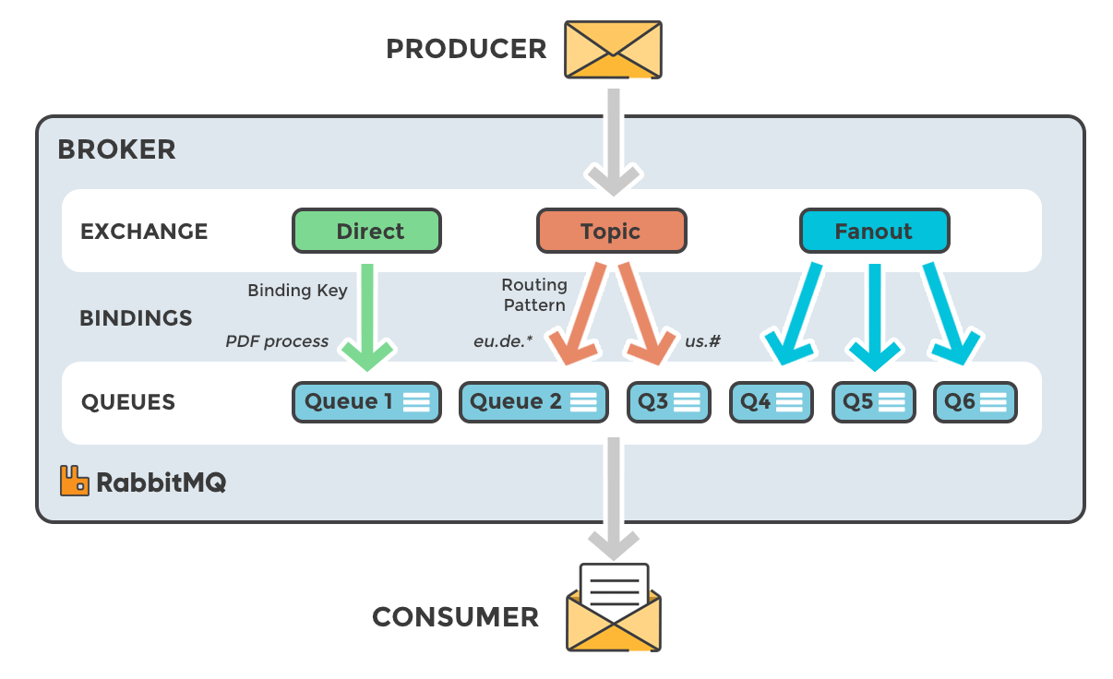
RabbitMQ structure

Slide 6
RabbitMQ main concepts
RabbitMQ broker: software that routes, stores, and delivers messages between producers and consumers. It is responsible for message delivery and ensuring that messages are properly routed and queued based on the specified configurations.
Producer: Application that sends the messages.
Consumer: Application that receives the messages.
Queue: storage mechanism that holds messages until they are consumed. It is a basic building block in RabbitMQ. Queues are bound to exchanges and store messages temporarily before they are processed.
Message: Information that is sent from the producer to a consumer through RabbitMQ. It typically includes a payload (the actual content), headers, and a routing key.
Connection: A TCP connection between your application and the RabbitMQ broker.
Channel: A virtual connection inside a connection. When publishing or consuming messages from a queue - it's all done over a channel.
Exchange: Receives messages from producers and pushes them to queues depending on rules defined by the exchange type. To receive messages, a queue needs to be bound to at least one exchange.
Binding: A binding is a link between a queue and an exchange.
Routing key: A key that the exchange looks at to decide how to route the message to queues. Think of the routing key like an address for the message.
AMQP: Advanced Message Queuing Protocol is the protocol used by RabbitMQ for messaging.
Users: It is possible to connect to RabbitMQ with a given username and password. Every user can be assigned permissions such as rights to read, write and configure privileges within the instance. Users can also be assigned permissions for specific virtual hosts.

Slide 7
RabbitMQ main concepts
Virtual Host (vhost): a logical grouping of queues, exchanges, and bindings. It allows you to isolate different applications or tenants within the same RabbitMQ instance. Each vhost has its own separate namespaces and security settings.
Acknowledgment (Ack): a signal sent from the consumer to RabbitMQ to indicate that a message has been successfully received and processed. If a message is not acknowledged, RabbitMQ will attempt to deliver the message again, or it may move the message to a Dead Letter Queue (DLQ).
Dead Letter Queue (DLQ): a special queue to which messages are moved when they can't be processed or delivered from the original queue. Messages may be dead-lettered due to expiration, rejection, or consumer failures. RabbitMQ supports configuring Dead Letter Exchanges (DLX) to automatically route failed messages to DLQs.
Time-to-Live (TTL): defines how long a message can live in a queue or how long a queue can exist. If the TTL expires before the message is consumed or the queue is deleted, RabbitMQ will either discard or dead-letter the message.
Priority Queue: it allows messages to be ordered by priority, where higher priority messages are consumed before lower priority ones. Messages in the same queue are processed in the order of their priority rather than the order they arrived.
Cluster: RabbitMQ supports clustering, where multiple RabbitMQ brokers (nodes) can be joined together to form a single logical broker. This allows for increased availability, load balancing, and fault tolerance.
RabbitMQ Management Interface: it provides a powerful, user-friendly web interface for monitoring, configuring, and managing RabbitMQ. It gives you visibility into the internal workings of your broker, allowing you to manage queues, exchanges, connections, users, and permissions. With its real-time monitoring capabilities, it’s an essential tool for administrators and developers working with RabbitMQ in production environments.

Slide 8
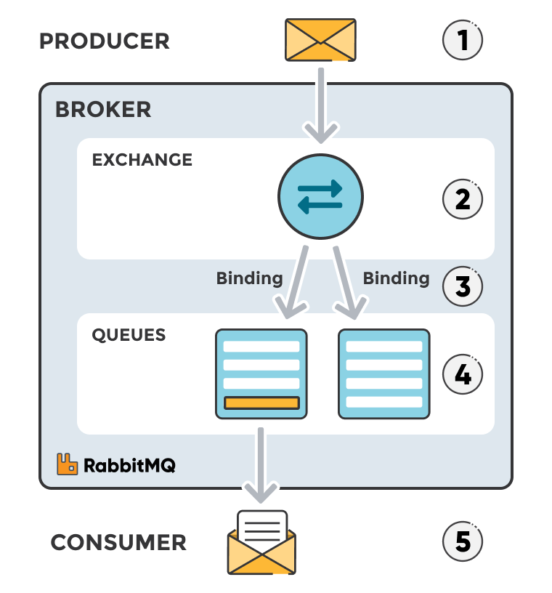
Message flow in RabbitMQ
The producer publishes a message to an exchange. When creating an exchange, its type must be specified.
The exchange receives the message and is now responsible for routing the message. The exchange takes different message attributes into account, such as the routing key, depending on the exchange type.
Bindings must be created from the exchange to queues. In this case, there are two bindings to two different queues from the exchange. The exchange routes the message into the queues depending on message attributes.
The messages stay in the queue until they are handled by a consumer.
The consumer handles the message.

Slide 9
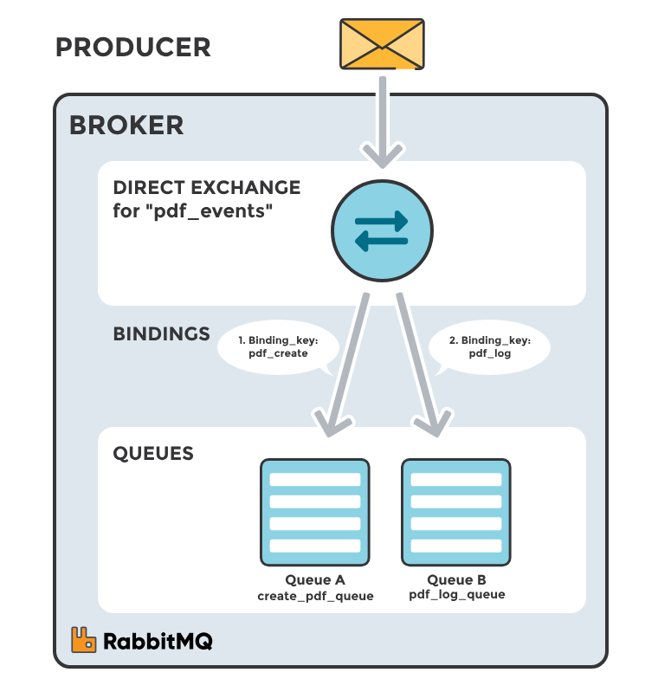
Exchange types
Direct Exchange
A direct exchange delivers messages to queues based on a message routing key. The routing key is a message attribute added to the message by the producer. Think of the routing key as an "address" that the exchange is using to decide how to route the message. A message goes to the queue(s) with the binding key that exactly matches the routing key of the message.
Scenario 1
queue A in the image is bound to a direct exchange (pdf_events) with the binding key - pdf_create. When a new message with routing key - “pdf_create” arrives at the direct exchange, the exchange routes it to the queue where the binding_key = routing_key, in the case to queue A.

Slide 10
Exchange types
What are the Exchange types?
Default Exchange
Conditions: If no exchange is specified or if the specified exchange does not exist, the default exchange will be used, and the routing key will be treated as the queue name.
Default exchange is a predefined, built-in exchange that is used when no other exchange is specified for a message. It is a direct exchange that routes messages to queues based on the routing key matching the queue name.
Key Points About the Default Exchange:
Type: The default exchange is a direct exchange.
Routing Key: The routing key used in the default exchange is exactly the name of the queue.
No Explicit Declaration: The default exchange doesn't need to be declared explicitly by the user; it is always available.
Direct Routing: Messages are routed directly to the queue whose name matches the routing key.
Use case:
You do not need to define it explicitly, and it is useful for simple routing scenarios where you want a message to be delivered directly to a specific queue based on the queue name as the routing key.

Slide 11
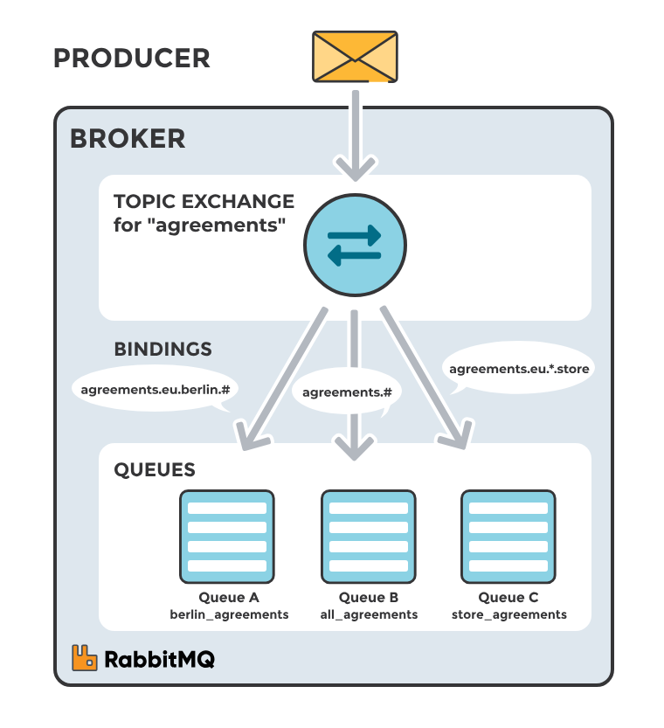
Exchange types
What are the Exchange types?
Topic Exchange
Topic exchanges route messages to queues based on wildcard matches between the routing key and the routing pattern, which is specified by the queue binding. Messages are routed to one or many queues based on a matching between a message routing key and this pattern.
Scenario 1
Exchange: agreements
Queue: berlin_agreements
Routing pattern between Exchange and Queue: agreements.eu.berlin.#
Example of message routing key that matches: agreements.eu.berlin and agreements.eu.berlin.store
Scenario 2
Exchange: agreements
Queue: all_agreements
Routing pattern between Exchange and Queue: agreements.#
Example of message routing key that matches: agreements.eu.berlin and agreements.us
Scenario 3
Exchange: agreements
Queue: store_agreements
Routing pattern between Exchange and Queue: agreements.eu.*.store
Example of message routing key that matches: agreements.eu.berlin.store and agreements.eu.stockholm.store

Slide 12
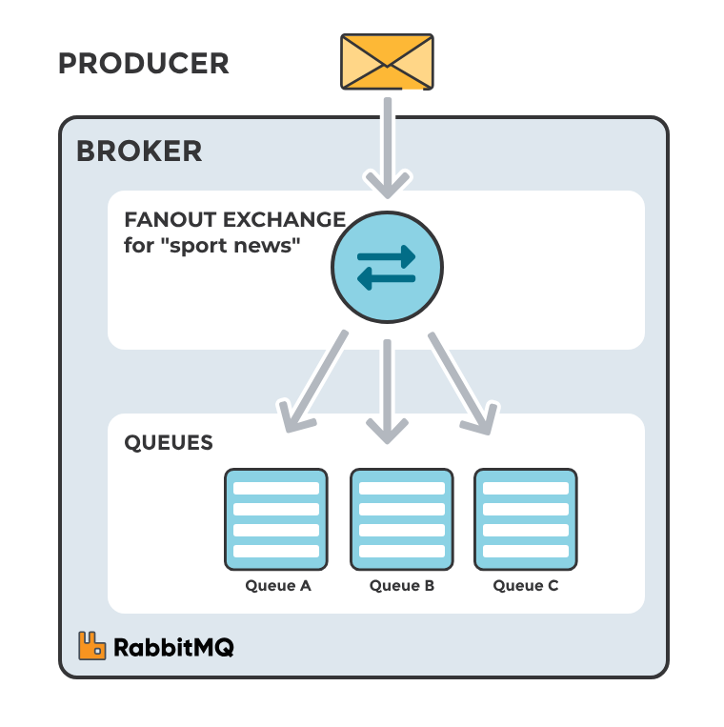
Exchange types
What are the Exchange types?
Fanout Exchange
A fanout exchange routes a received message to all queues that are bound to it regardless of routing keys or pattern matching as with direct and topic exchanges. The keys provided will simply be ignored.
Fanout exchanges can be useful when the same message needs to be sent to one or more queues with consumers who may process the same message in different ways.
Scenario 1
The image to the right shows an example where a message received by the exchange is routed to all three queues bound to the exchange.

Slide 13
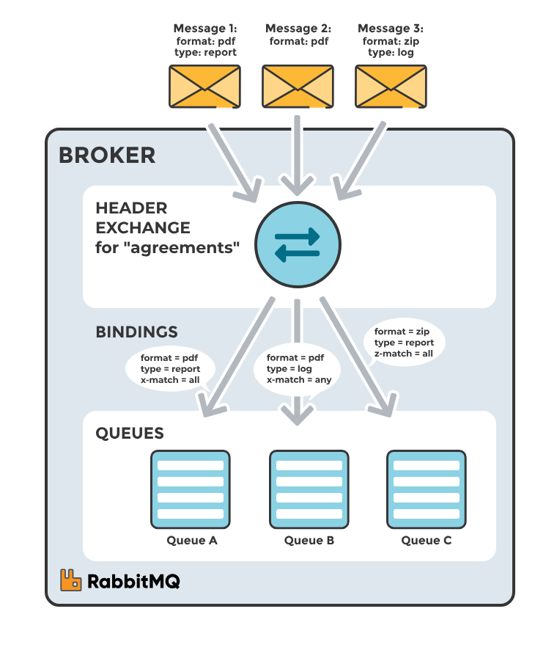
Exchange types
What are the Exchange types?
Headers Exchange
Headers Exchange routes messages based on message header attributes rather than the routing key. It allows for more flexible routing, as messages can be routed to queues based on headers in the message, such as content type, region, priority, or other key-value pair.
A special argument named "x-match", added in the binding between exchange and queue, specifies if all headers must match or just one. The "x-match" property can have two different values: "any" or "all", where "all" is the default value.
Scenario 1
Message 1 is delivered to Queue A because all key/value pairs match, and Queue B since "format = pdf" is a match (binding rule set to "x-match =any").
Scenario 2
Message 2 is only delivered to Queue B. Because the binding of Queue A requires both "format = pdf" and "type = report" while Queue B is configured to match any key-value pair (x-match = any).
Scenario 3
Message 3 is delivered to Queue B since its binding indicates that it accepts messages with the key-value pair "type = log", it doesn't mind that "format = zip" since "x-match = any". Queue C doesn't receive any of the messages since its binding is configured to match all of the headers ("x-match = all") with "format = zip", "type = pdf".

Slide 14
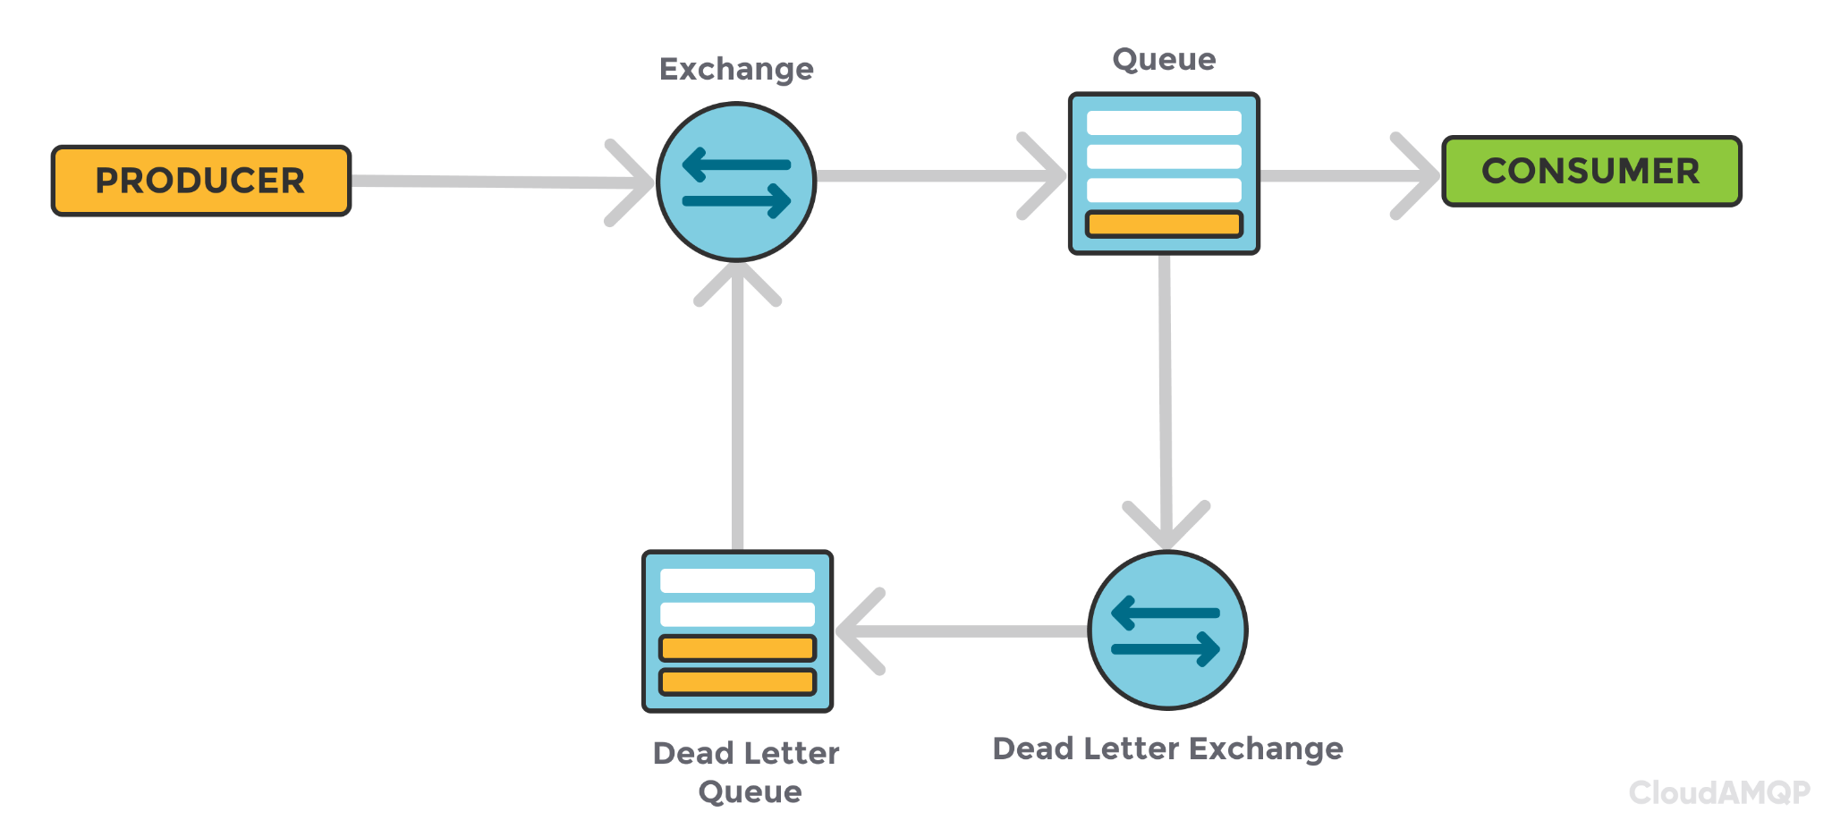
Dead-Letter queue
A Dead Letter Queue (DLQ) is a backup queue that stores unprocessed or failed messages for debugging, monitoring, and reprocessing.
Why Do Messages Go to DLQ?
Message Expiration – TTL (Time-To-Live) exceeded.
Queue Overflow – The main queue is full.
Message Rejected – Consumer rejects the message without requeueing.
How DLQ Works?
A main queue is configured with a Dead Letter Exchange (DLX).
If a message fails, it is redirected to the DLQ for debugging or reprocessing.

Slide 15
1. Queue and Exchange Design
Use Exchanges Efficiently: Choose the correct exchange type (direct, topic, fanout, or headers) based on your routing needs.
Avoid Overloading Queues: Don't let queues grow indefinitely; use message TTL (Time-to-Live) and Dead Letter Exchanges to handle expired or undelivered messages.
Limit Queue Length: Set a max-length or max-length-bytes policy to prevent memory overload.
Use Durable Queues: Make queues and exchanges durable if you need persistence across broker restarts.
2. Message Design and Handling
Keep Messages Small: Aim for messages under 100 KB. For large payloads, use references to external storage (e.g., S3).
Idempotency: Ensure consumers handle message re-delivery gracefully to avoid duplicate processing.
Acknowledge Messages Properly: Use manual acknowledgments (autoAck: false) for reliable delivery and to avoid message loss.
3. Consumer Design
Error Handling: Implement retry logic and Dead Letter Exchanges for failed messages.
Consumer Load Balancing: Distribute messages evenly by scaling consumers across multiple instances.
Best practices and important rules

Slide 16
4. Monitoring and Maintenance
Enable Monitoring: Use RabbitMQ Management Plugin, Prometheus, or Grafana to monitor metrics like queue length, message rates, and resource usage.
Regular Maintenance: Perform regular maintenance, including purging unused queues and updating RabbitMQ versions.
5. Development and Deployment
Environment Configuration: Separate development and production configurations, especially for exchanges, queues, and routing keys.
CI/CD Integration: Automate RabbitMQ configuration deployment using tools like Docker or Infrastructure as Code (IaC).
6. Security and Reliability
Enable SSL/TLS: Use SSL/TLS to secure communication between producers, consumers, and RabbitMQ.
Authentication and Authorization: Use RabbitMQ built-in authentication mechanisms and set up appropriate user permissions.
Cluster Setup and HA: Deploy RabbitMQ in a cluster with mirrored queues for high availability and fault tolerance.
Best practices and important rules

Slide 17


Thank you for your attention!

